Slide 1
MINI PROJECT 1 Embedded I/O – Graphics LCD & periodic timer interrupts
William Trace LaCour (WTL6C)

Slide 2
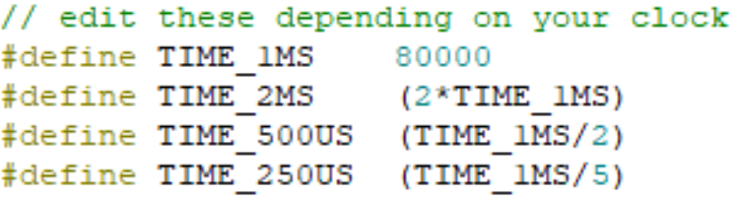

Deliverables for part 2 - calculations
On line 15 in OS.h I found that 1 ms was equal to 80,000 system ticks. This is clock dependent.
The PERIOD macro needed to be set so that the timer frequency was 20 Hz (Twice as fast as the heart beat signal measured on the logic analyzer). I used the following calculation to help find my macro value.
$$Period \left(ms\right)=\frac{1}{frequency (Hz)}= \frac{1}{20}=50 ms$$
After finding that the required timer period was 50 ms I multiplied it by 80000 (1 ms). I knew that since every time the producer ran it would only toggle the heartbeat signal which means it would take two cycles of the timer to produce one cycle of the heartbeat signal. The following slide shows the time for half a cycle of the heartbeat signal which I used to verify my timer frequency of 20Hz. I adjusted the PERIOD macro to get as close as I could to 50ms but the closest I could get was 50.21 ms.
PERIOD = 50 * 80000 = 4,000,000

Slide 3
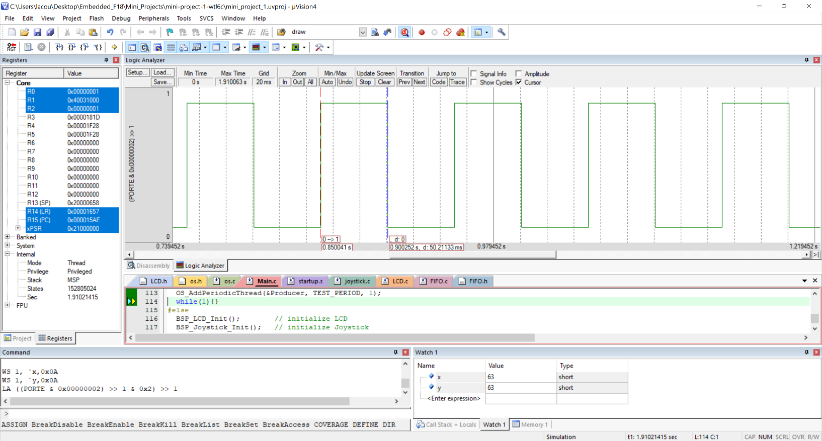


Deliverables for part 2 – Logic Analyzer
$$Frequency=\frac{1}{50.211 ms}=19.92 Hz ≈ 20 Hz$$

Slide 4
Deliverables for part 4 – Video
https://drive.google.com/open?id=1HOh3iAts050_gTrf6zec3_pCDCdW7gTO
I made it so that anyone with a UVA email can access this video. I hope this works for you. If it does not I included a file called VIDEO_LINK.txt in my github that you can copy and paste into your browser.

Slide 5
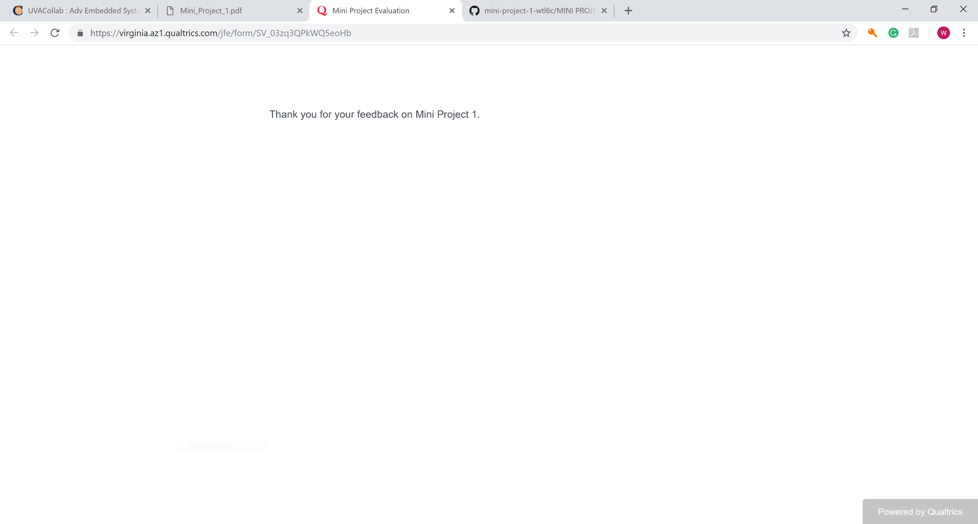
Survey screenshot

